Slide 1
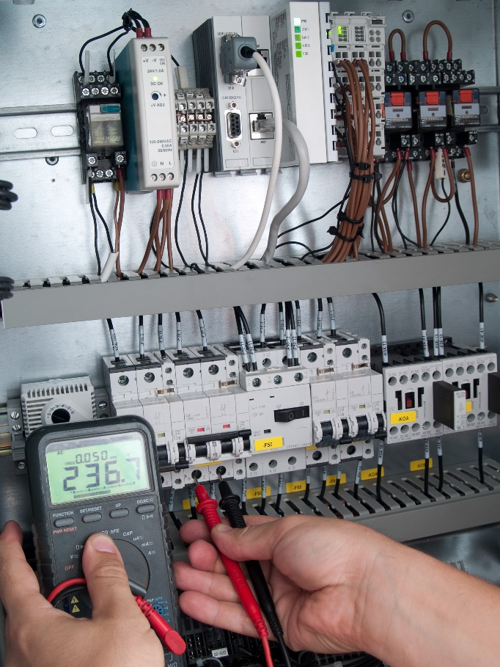
Testing with JUnit
Test Driven Development
JUnit: Command Line
JUnit: Eclipse Plugin

Slide 2
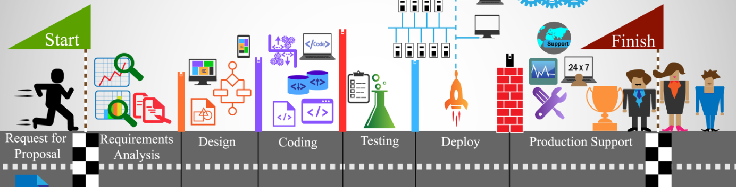
See Also
https://en.wikipedia.org/wiki/Test-driven_development
http://junit.org/junit4/
Notes:
Some additional information on concurrency

Slide 3
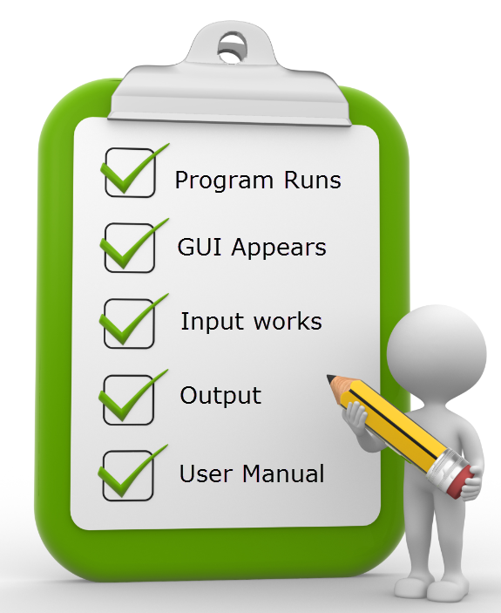
Test Driven Development
Write the test cases first
The test cases initially fail
Write the code to pass tests
Continuous integration
Streams of bytes … two ways (into your program and out of your program)
Disks, consoles, sockets, keyboards, printers
Know how to talk streams and you can talk to anything
Initialization (constructor) is different. Use is the same.

Slide 4

Calculator
public class MathFunctions {
public int add(int a, int b) {
return 0;
}
public int add(int a, int b, int c) {
return 0;
}
public int subtract(int a, int b) {
return 0;
}
public int multiply(int a, int b) {
return 0;
}
public int divide(int a, int b) {
return 0;
}
}
Streams of bytes … two ways (into your program and out of your program)
Disks, consoles, sockets, keyboards, printers
Know how to talk streams and you can talk to anything
Initialization (constructor) is different. Use is the same.

Slide 5
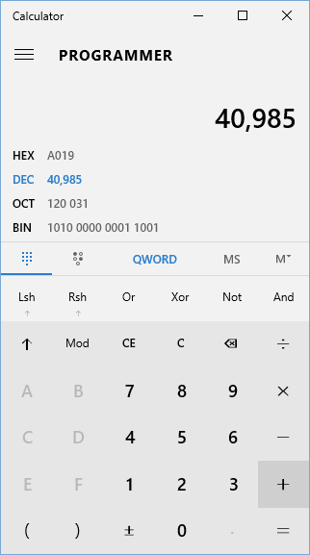
Unit Tests
public class Calculator {
public static void main(String[] args) {
// This is our calculator application
// TODO Read command line
// TODO Perform calculation
// TODO Print result
}
}
public void testMultiply() ...
public void testDivide() ...
public void testAddTwo() {
MathFunctions funcs = new MathFunctions();
int res = funcs.add(5, 10);
if(res!=15) {
System.out.println("OOPS! I didn't get 15!");
}
}
As a “main” in MathFunctions?
As a “main” in a new class?
Streams of bytes … two ways (into your program and out of your program)
Disks, consoles, sockets, keyboards, printers
Know how to talk streams and you can talk to anything
Initialization (constructor) is different. Use is the same.

Slide 6
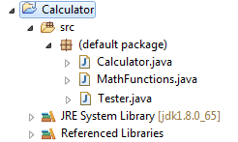
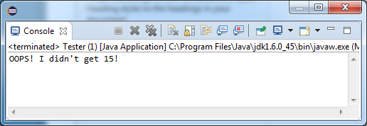
Unit Tests
public class Tester {
public static void testAddTwo() {
MathFunctions funcs = new MathFunctions();
int res = funcs.add(5, 10);
if(res!=15) {
System.out.println("OOPS! I didn't get 15!");
}
// Continue with testing?
// How to record failures?
// How to handle exceptions?
}
public static void main(String[] args) {
testAddTwo();
// testMultiply();
// testDivide();
}
}
Streams of bytes … two ways (into your program and out of your program)
Disks, consoles, sockets, keyboards, printers
Know how to talk streams and you can talk to anything
Initialization (constructor) is different. Use is the same.

Slide 7
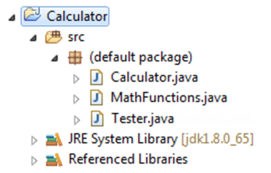
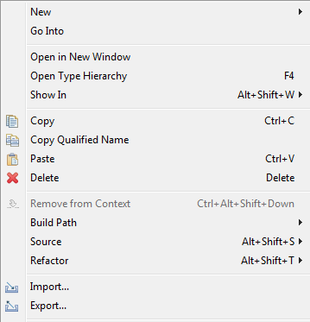
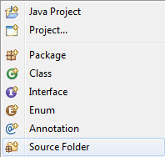
Test Source Directory
Streams of bytes … two ways (into your program and out of your program)
Disks, consoles, sockets, keyboards, printers
Know how to talk streams and you can talk to anything
Initialization (constructor) is different. Use is the same.

Slide 8
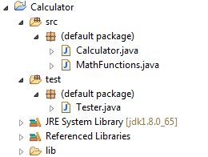
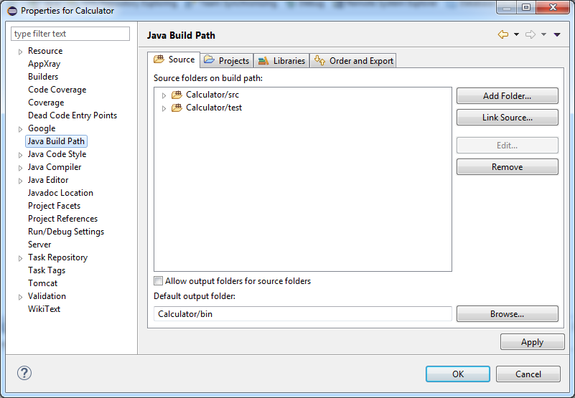
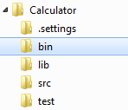
Test Source Directory
Streams of bytes … two ways (into your program and out of your program)
Disks, consoles, sockets, keyboards, printers
Know how to talk streams and you can talk to anything
Initialization (constructor) is different. Use is the same.

Slide 9
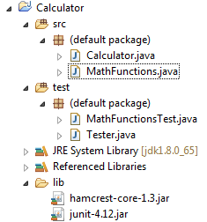
Unit Tests
import static org.junit.Assert.assertTrue;
import org.junit.Test;
public class MathFunctionsTest {
@Test
public void testAddTwo() {
MathFunctions funcs = new MathFunctions();
int res = funcs.add(5, 10);
assertTrue(res==15);
}
}
Streams of bytes … two ways (into your program and out of your program)
Disks, consoles, sockets, keyboards, printers
Know how to talk streams and you can talk to anything
Initialization (constructor) is different. Use is the same.

Slide 10
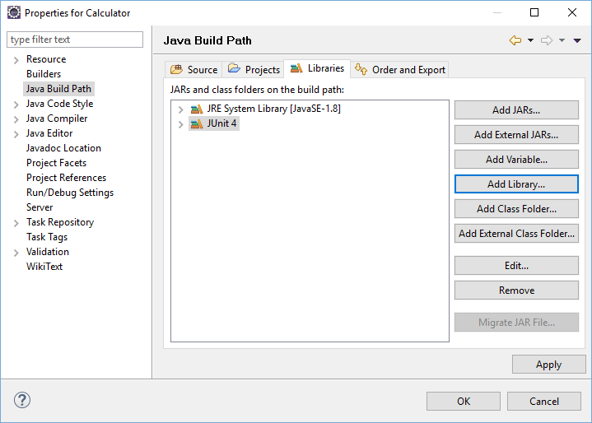
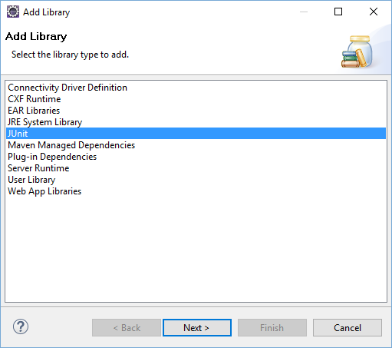
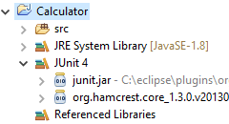
JAR Files
Streams of bytes … two ways (into your program and out of your program)
Disks, consoles, sockets, keyboards, printers
Know how to talk streams and you can talk to anything
Initialization (constructor) is different. Use is the same.

Slide 11
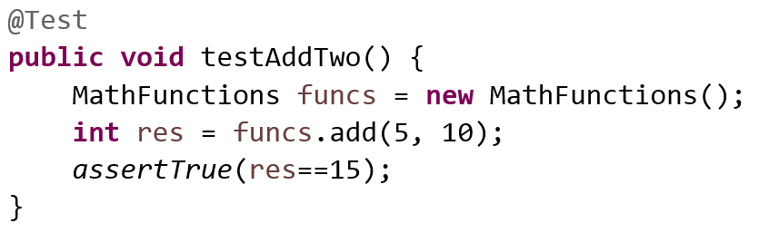
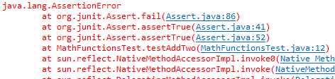
Unit Tests
import java.util.List;
import org.junit.runner.JUnitCore;
import org.junit.runner.Result;
import org.junit.runner.notification.Failure;
public class Tester {
public static void main(String[] args) {
Result res = JUnitCore.runClasses(MathFunctionsTest.class);
System.out.println(res.getRunCount());
System.out.println(res.getFailureCount());
System.out.println(res.getRunTime());
List<Failure> fails = res.getFailures();
for(Failure f : fails) {
f.getException().printStackTrace();
}
}
}
1
1
8
Streams of bytes … two ways (into your program and out of your program)
Disks, consoles, sockets, keyboards, printers
Know how to talk streams and you can talk to anything
Initialization (constructor) is different. Use is the same.

Slide 12
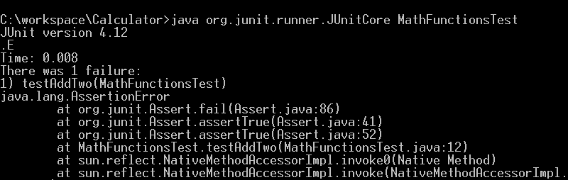
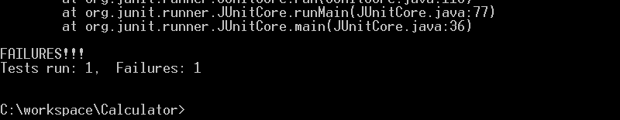
Command Line
Streams of bytes … two ways (into your program and out of your program)
Disks, consoles, sockets, keyboards, printers
Know how to talk streams and you can talk to anything
Initialization (constructor) is different. Use is the same.

Slide 13
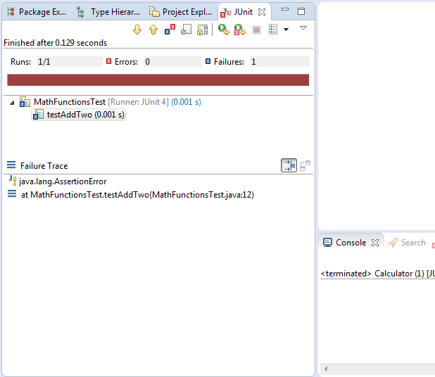
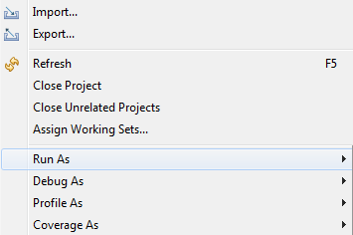
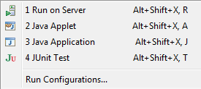
Eclipse UI
Streams of bytes … two ways (into your program and out of your program)
Disks, consoles, sockets, keyboards, printers
Know how to talk streams and you can talk to anything
Initialization (constructor) is different. Use is the same.

Slide 14
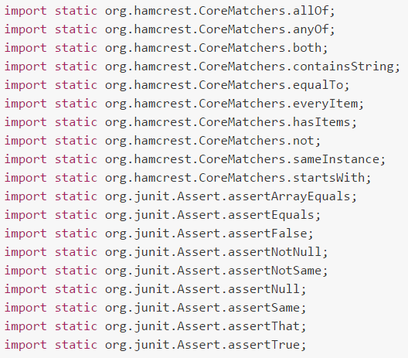
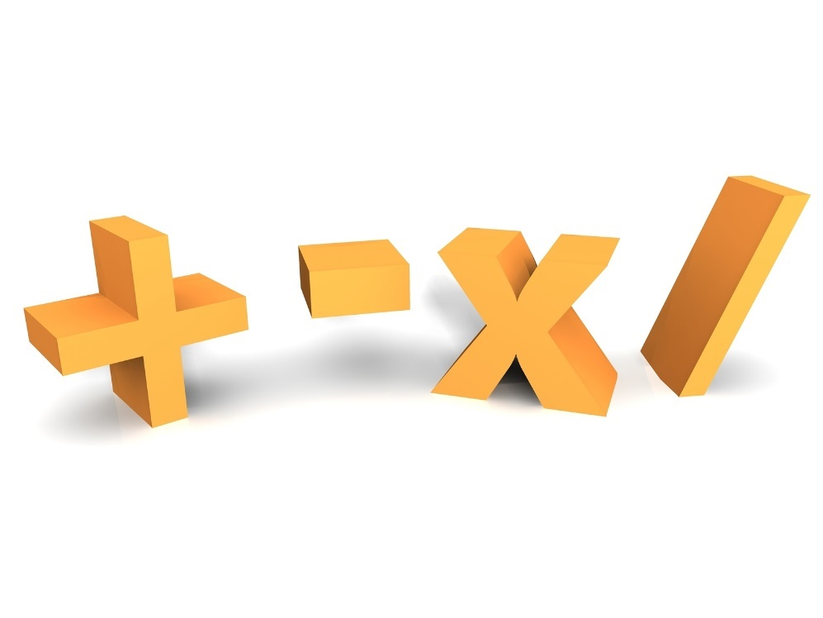
Asserts
@Test
public void testStuff() {
List<String> ar = Arrays.asList("one", "two", "three");
assertThat(ar, hasItems("one", "three"));
}
Streams of bytes … two ways (into your program and out of your program)
Disks, consoles, sockets, keyboards, printers
Know how to talk streams and you can talk to anything
Initialization (constructor) is different. Use is the same.

Slide 15
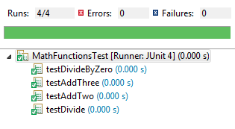
Writing Tests
public class MathFunctionsTest {
private MathFunctions funcs = new MathFunctions();
@Test
public void testAddTwo() {
int res = funcs.add(5, 10);
assertTrue(res==15);
}
@Test
public void testDivide() {
int res = funcs.divide(81, 9);
assertTrue(res==9);
}
@Test
public void testDivideByZero() {
try {
funcs.divide(20, 0);
fail("Division by zero didn't fail");
} catch (ArithmeticException e) {
// Expected
}
}
}
public class MathFunctions {
public int add(int a, int b) {
return a+b;
}
public int add(int a, int b, int c) {
return a+add(b,c);
}
public int divide(int a, int b) {
return a/b;
}
}
Streams of bytes … two ways (into your program and out of your program)
Disks, consoles, sockets, keyboards, printers
Know how to talk streams and you can talk to anything
Initialization (constructor) is different. Use is the same.

Slide 16

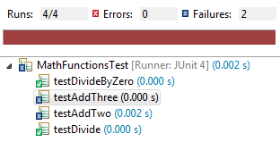
Writing Tests
public class MathFunctions {
public int add(int a, int b) {
return a - b;
}
public int add(int a, int b, int c) {
return a+add(b,c);
}
public int divide(int a, int b) {
return a/b;
}
}
Streams of bytes … two ways (into your program and out of your program)
Disks, consoles, sockets, keyboards, printers
Know how to talk streams and you can talk to anything
Initialization (constructor) is different. Use is the same.

Slide 17
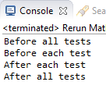
Test Setup
public class MathFunctionsTest {
private MathFunctions funcs = new MathFunctions();
@AfterClass
public static void tearDown() {
System.out.println("After all tests");
}
@BeforeClass
public static void setup() {
System.out.println("Before all tests");
}
@Before
public void eachOne() {
System.out.println("Before each test");
}
@After
public void afterOne() {
System.out.println("After each test");
}
@Test
public void testAddTwo() {
int res = funcs.add(5, 10);
assertTrue(res==15);
}
}
Streams of bytes … two ways (into your program and out of your program)
Disks, consoles, sockets, keyboards, printers
Know how to talk streams and you can talk to anything
Initialization (constructor) is different. Use is the same.

Slide 18
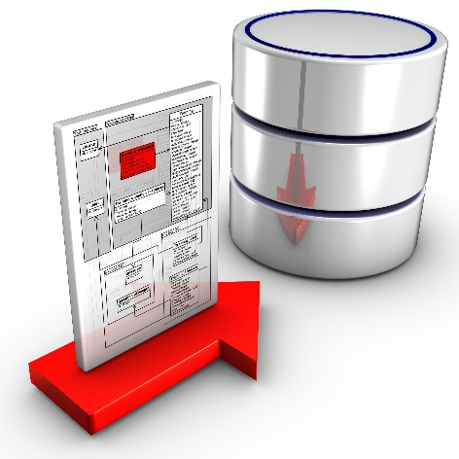
Unit Tests on a Database
Use Docker to create Database VM in known state
Use a test SQL script to create a known state
Create/destroy the known state in your tests
Use transactions and rollback after every test

Slide 19

Tinkering
Try the Calculator example with one source directory. Then move test code to another source directory.
Write test cases for the “sellBook” DAO function in the previous lesson.

